Slide 1
Music Will Iconic Notation Library
Use this PowerPoint to make custom song charts and lessons for your students!

Slide 2
TABLE OF CONTENTS
How to Use this Document
Measures and Bar Line Elements
Guitar
Keyboard
Ukulele
Bass
Drums
3
4
5-12
14-21
22-32
33-41
42-47

Slide 3
How To Use This Document
Make a copy of this document by going to File -> Make a Copy -> Entire Presentation.
Choose the slide on the next page titled “Measures and Bar Lines”. This will be your song chart. Duplicate this slide as many times as you want to for as many song charts as you’d like to make.
Copy and paste ingredients from other slides onto your new blank slide one at a time or select multiple items from the same slide to copy by holding down shift while selecting objects.
Re-size any object by selecting it and then clicking and dragging one of the corners of the object to the desired size. Multiple objects can be resized at the same time by making sure they are simultaneously selected.
Holding the Command (ctrl alt on windows) while pressing “+” or “-” will allow you to zoom in or out of a page to fine tune the positioning of objects. Objects can be moved by being dragged into position or nudged using the arrow keys.
Double click anywhere to begin a new text box.
Text can be resized by selecting it and changing its font size.
Print your new song chart by choosing “print” from the file menu, and then make sure that only the slide number containing your chart is selected in the print dialog box.
Save your new song chart as a PDF by choosing this option at the bottom of the print dialog box and typing a new title for the song chart.

Slide 4
Measures and Bar Lines
Drag a repeat sign over a bar line, resize, create your own measures, etc…

Slide 5
Measures and Bar Lines
Drag a repeat sign over a bar line, resize, create your own measures, etc…

Slide 6
Measures and Bar Lines
Drag a repeat sign over a bar line, resize, create your own measures, etc…

Slide 7
GUITAR
ICONIC NOTATION LIBRARY

Slide 8
Table of Contents
GUITAR
SLIDE 4 – Open Chords and 3-String chords
SLIDE 5 – Other Open Chords
SLIDE 6 – “E” Style Chords: 5, Maj, Min, Dom7, Min7, Maj7
SLIDE 7 – “A” Style Chords: 5, Maj, Min, Dom7, Min7, Maj7
SLIDE 8 – Scales: Maj & Min Pentatonic, Blues
SLIDE 9 – Common Strum Patterns
SLIDE 10 – Strum Patterns Library
SLIDE 11 – Build Your Own Elements

Slide 9
Open Chords
3 String Versions of Open Chords

Slide 10
Open 7th, sus, and add Open Chords

Slide 11
Open 7th, sus, and add Open Chords

Slide 12
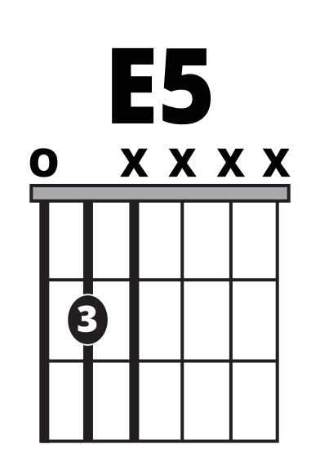
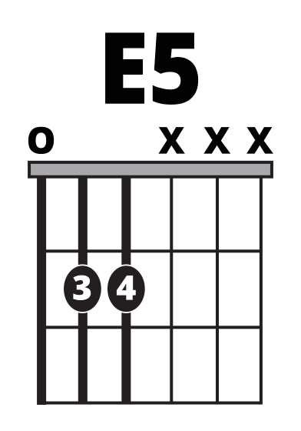
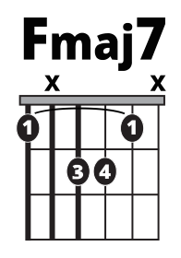
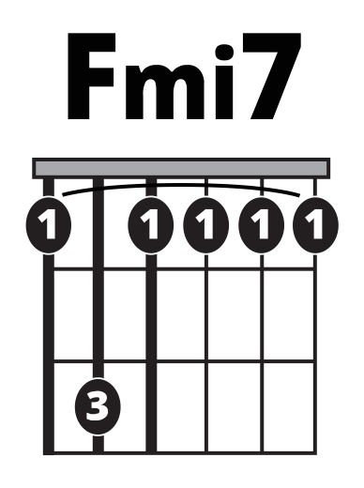
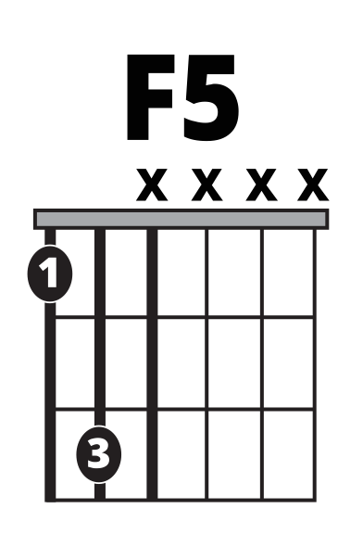
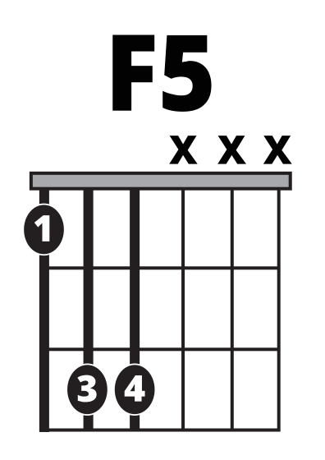
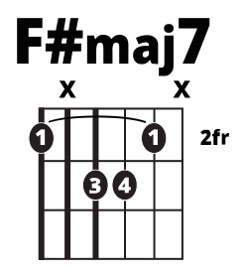

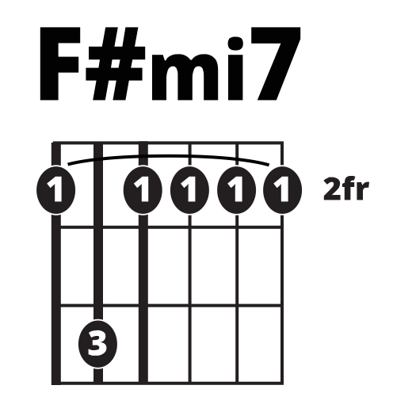
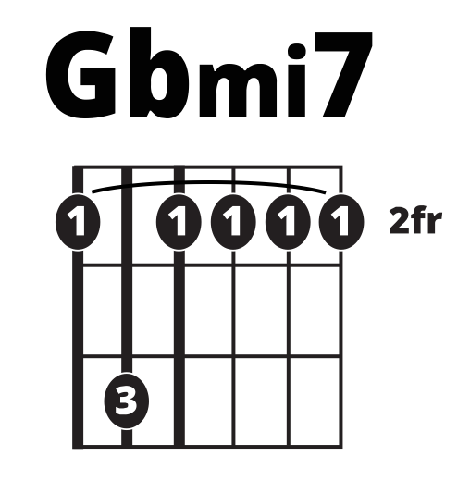
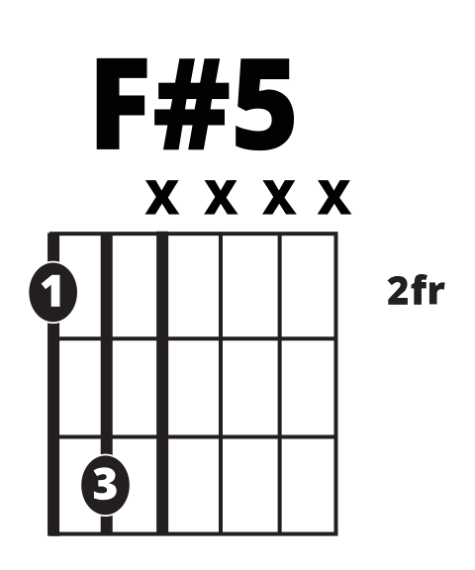
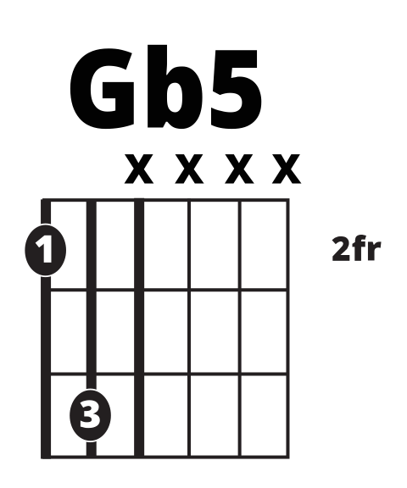
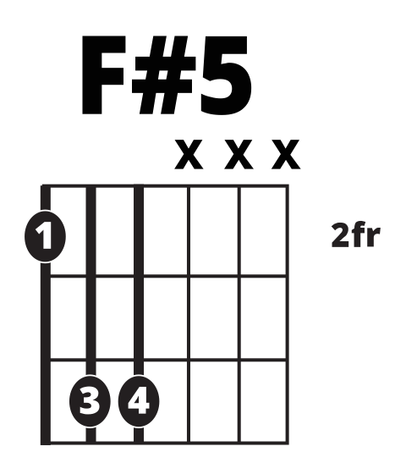

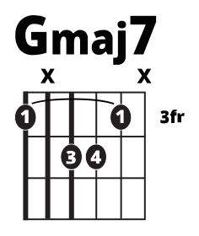
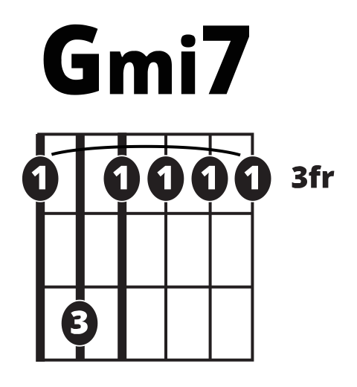
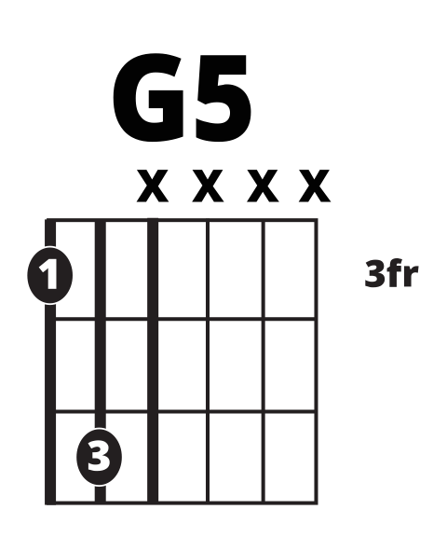
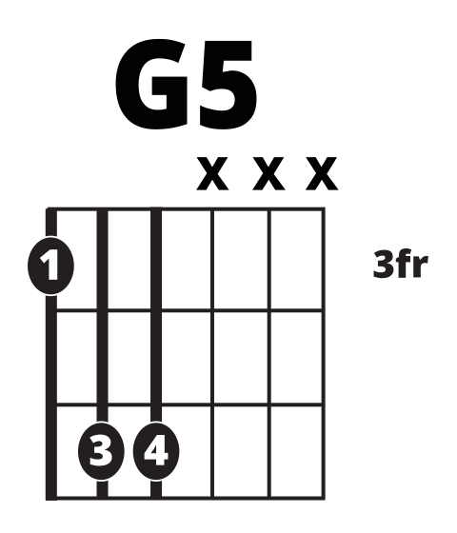

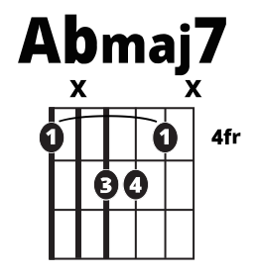
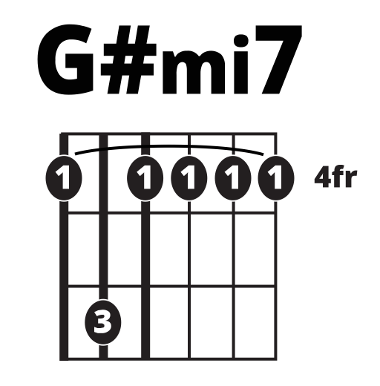
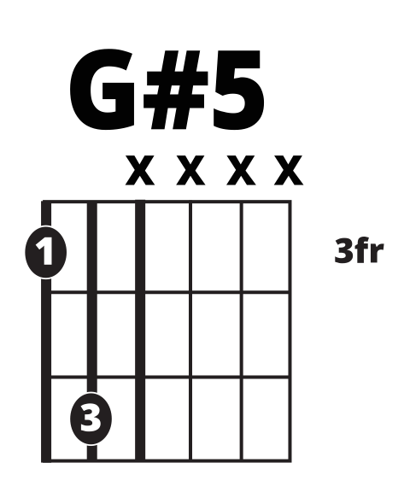

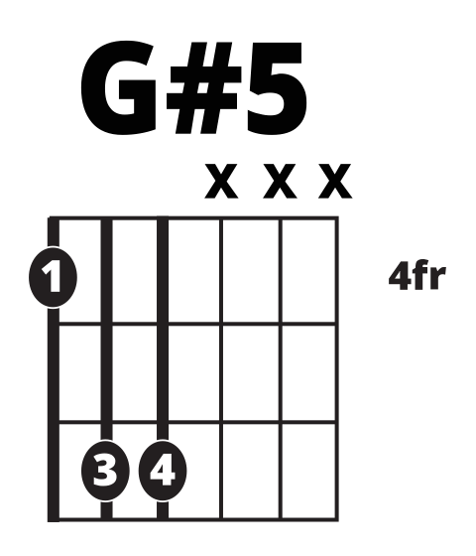

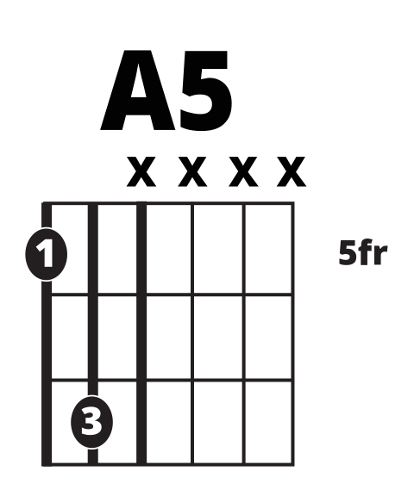
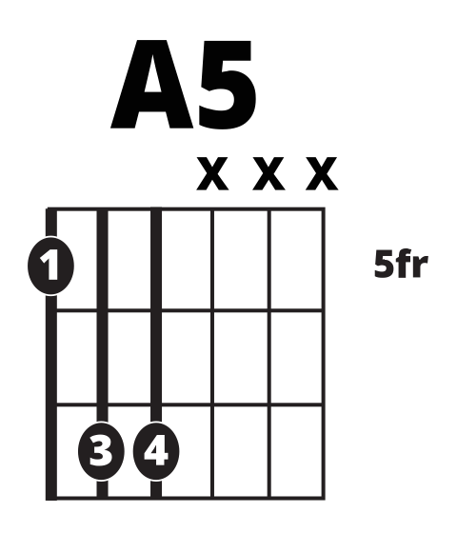
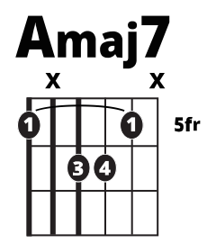

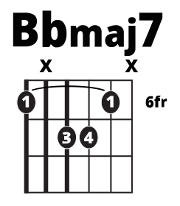
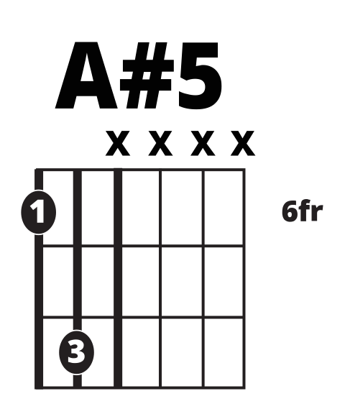
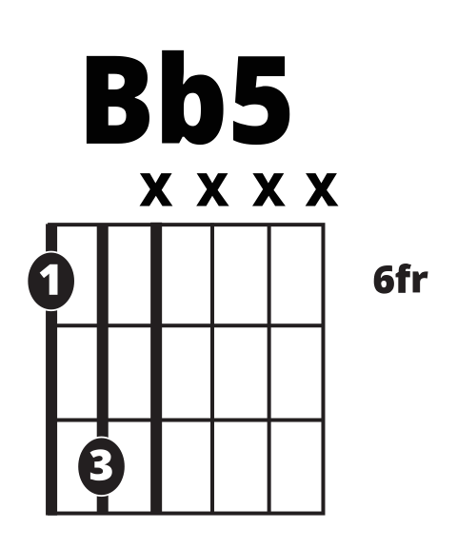



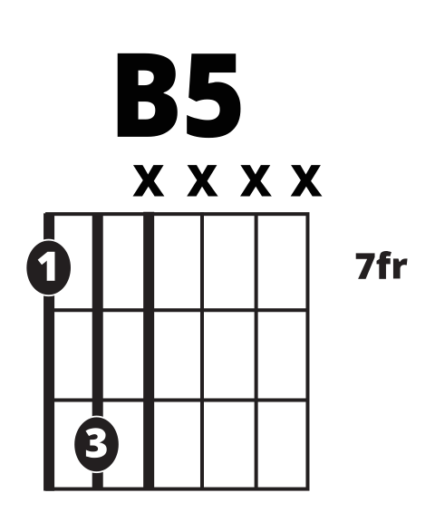


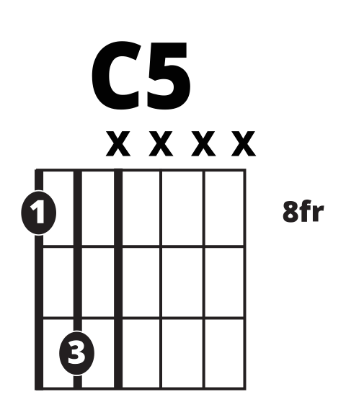


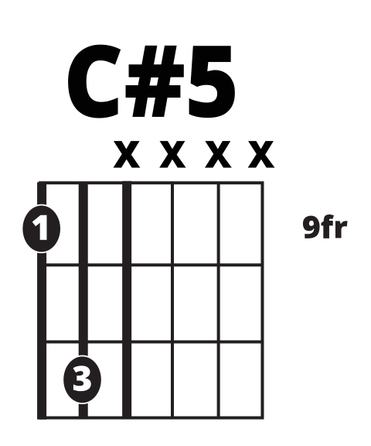

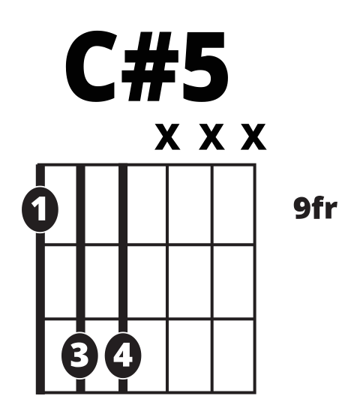

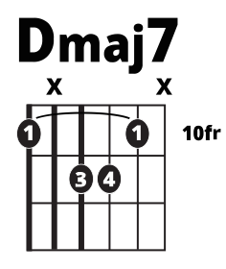
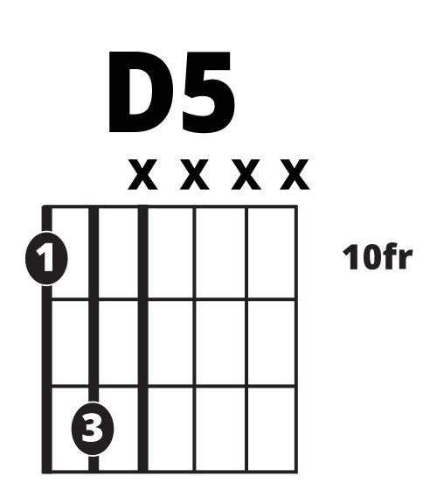
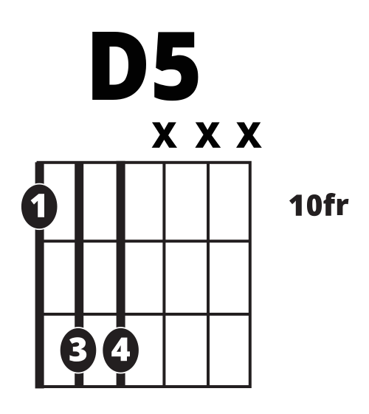
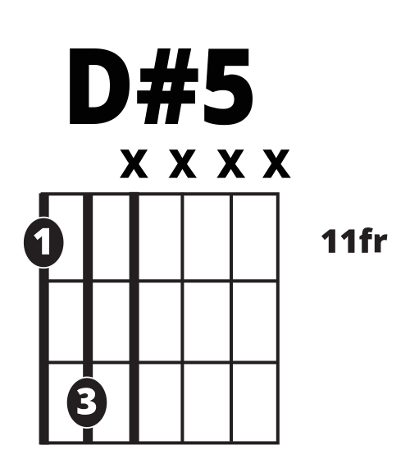

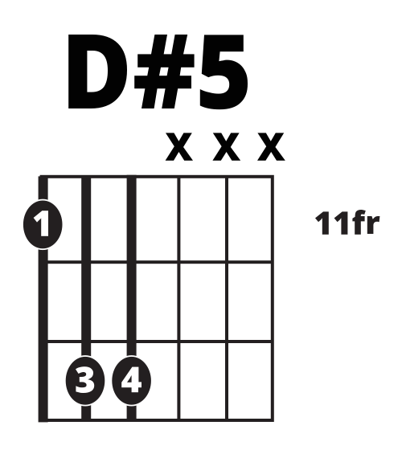


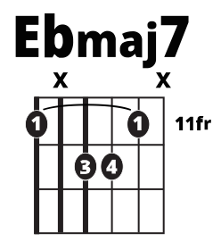

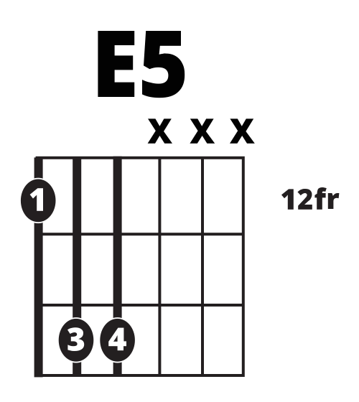
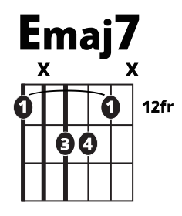
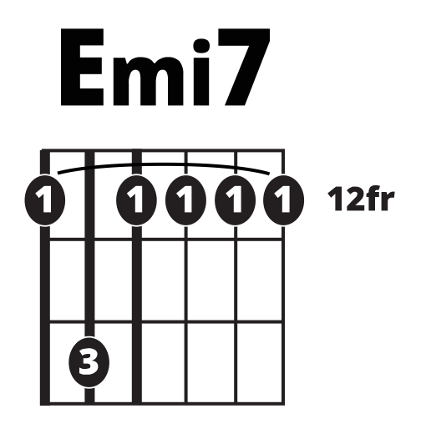
E Style Power and Barre Chords
2 Finger Power
3 Finger Power
Major
Minor
Dom7
Maj7
Min7

Slide 13
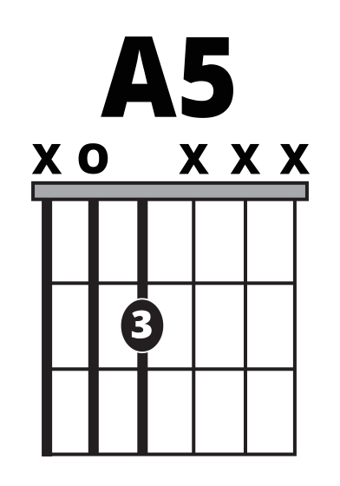
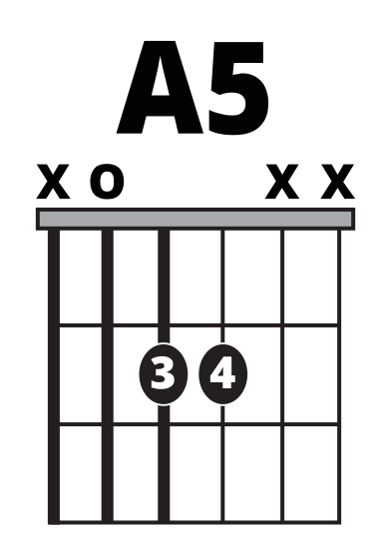
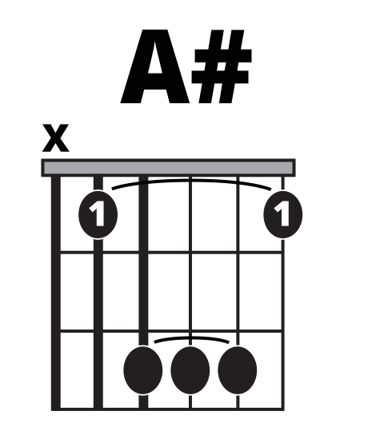
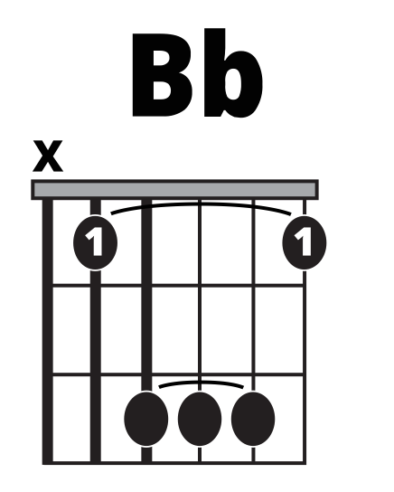
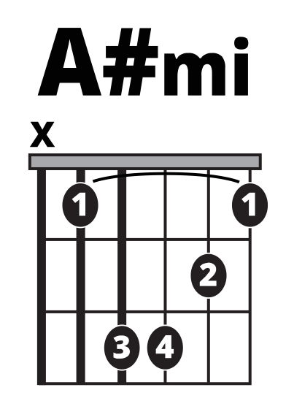
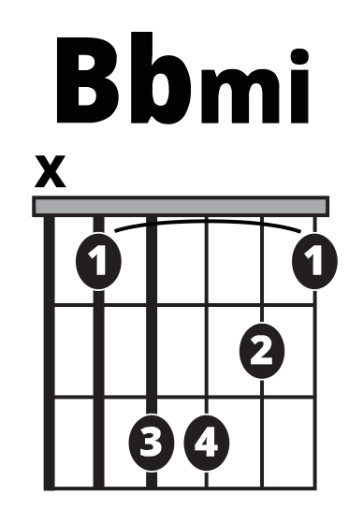
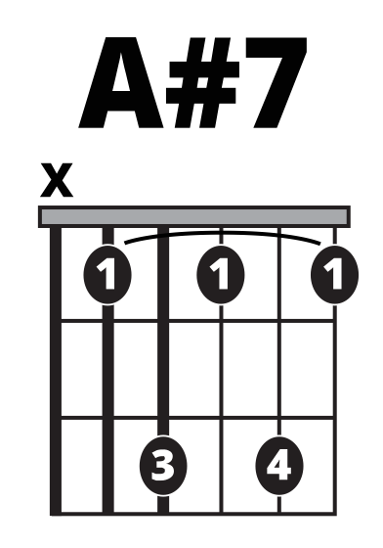
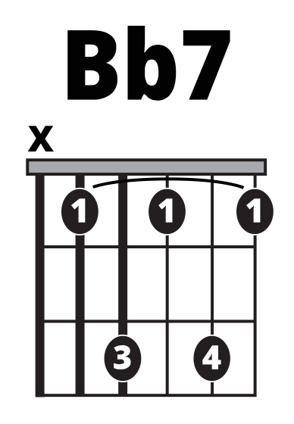
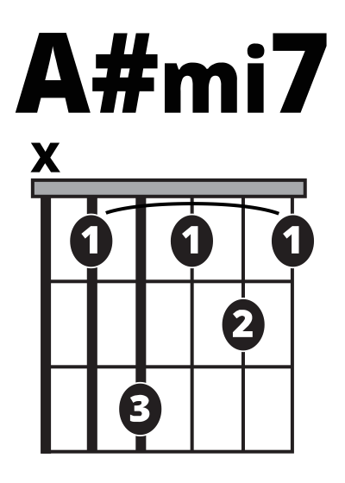
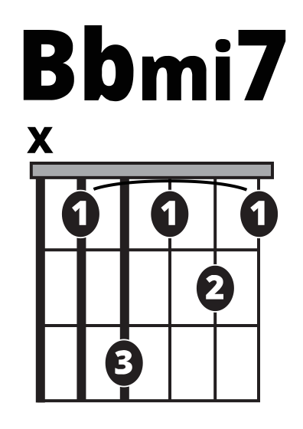
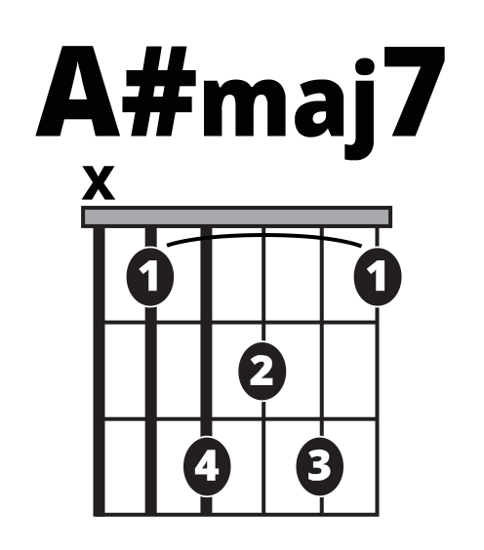














































































































A Style Power and Barre Chords
2 Finger Power
3 Finger Power
Major
Minor
Doc7
Minor 7
Maj 7

Slide 14

























































































Scales
Maj Pentatonic
Minor Pentatonic
Blues
Maj
Minor

Slide 15












Common 8th Note Comping Patterns
Common 16th Note Comping Patterns

Slide 16
























8th Note Comping Patterns

Slide 17

























Build-Your-Own Elements
Strum Pattern Template
Place these objects on or over chord boxes. Copy and paste to make duplicates. They can be resized.
Click on the chord letter or fret number to type a new one.
A7
8fr
3 Fret Chord Boxes
4 Fret Chord Boxes

Slide 18


























Build-Your-Own Guitar Tab
Drag numbers onto string lines, drag a repeat sign over the beginning or the end, crop an image to create custom lengths, resize, etc.
Hint: Zoom in (from view menu) to make placing images easier!

Slide 19

Keyboard
ICONIC NOTATION LIBRARY

Slide 20
Table of Contents
Keyboard
SLIDE 15 – Beginner Chords
SLIDE 16 – Major and Minor Chords in Root, 1st and 2nd Inversion
SLIDE 17 – Dom7, Maj7, Min7 Chords
SLIDE 18 – Scales: Major, Minor pentatonic, Blues
SLIDE 19 – Common Comping patterns
SLIDE 20 – More Comping patterns
SLIDE 21 – Build-Your-Own elements

Slide 21




































White Key Chords
One Black Key
Two-Note Chords

Slide 22






































































































Major and Minor Chords
Root Position Major
1st Major
2nd Major
Root Minor
1st inversion minor
2nd inversion minor

Slide 23




































































Power and 7 Chords
Power Chords
Dom 7 Chords
Min 7 Chords
Maj 7 Chords

Slide 24



















































































Scales
Major Pentatonic
Minor Pentatonic
Blues
Major
Minor

Slide 25












Common Comping Patterns

Slide 26









































More Comping Patterns

Slide 27








Build-Your-Own Elements
Copy and drag these notes onto any key on these keyboards to create any chord or scale!
White Key
Black Key
Click on the chord letter to type a new one.
A7
16th note grid
8th note grid
Drag these notes onto the 8th or 16th note grids below to create your own keyboard playing styles!
12/8 grid
6/8 grid

Slide 28

Ukulele
ICONIC NOTATION LIBRARY

Slide 29
Table of Contents
Ukulele
SLIDE 23 – Open chords
SLIDE 24 – Major and Minor Barre Chords
SLIDE 25 – Dom7, Min7, Maj7 Barre Chords
SLIDE 26 – Common Strum patterns
SLIDE 27 – More Strum patterns
SLIDE 29 – Scales: Major, Minor, Pentatonic, Blues
SLIDE 31 – Build-Your-Own Elements

Slide 30




















Open Chords
Open Chord Variations

Slide 31





































































Major and Minor Barre Chords
“F” Shape Barre
“C” Shape Barre
“A” Shape Barre
“Am” Shape Barre
“F#m” Shape Barre
“Dm” Shape Barre

Slide 32






































































Major and Minor Barre Chords
“A7” Shape Barre
“Cmaj7” Shape Barre
“C7” Shape Barre
“Em7” Shape Barre
“D7” Shape Barre
“Gmaj7” Shape Barre

Slide 33
Common 8th Note Comping Patterns
Common 16th Note Comping Patterns

Slide 34
Common 8th Note Comping Patterns
Common 16th Note Comping Patterns

Slide 35
8th Note Comping Patterns

Slide 36












16th Note Comping Patterns

Slide 37


































































Scales
Major Pentatonic
Major Pentatonic
Minor Pentatonic
Minor Pentatonic
Blues
Blues

Slide 38
























































Scales
Major Pentatonic
Minor Pentatonic
Blues
Major Scales
Minor Scales

Slide 39
Build Your Own Elements
5 Fret Chord Boxes
Place these objects on or over chord boxes. Copy and paste to make duplicates. They can be resized.
Click on the chord letter or fret number to type a new one.
A
4fr
Strum Pattern Template
4 Fret Chord Boxes

Slide 40
Build-Your-Own Uke Tab
Drag numbers onto string lines, drag a repeat sign over the beginning or the end, crop an image to create custom lengths, resize, etc.
Hint: Zoom in (from view menu) to make placing images easier!

Slide 41
Bass
ICONIC NOTATION LIBRARY

Slide 42
Table of Contents
Bass
SLIDE 34 – Bass Notes
SLIDE 35 – Scales: Major, Minor, Pentatonic, Blues
SLIDE 36 – Bass Arpeggio Patterns
SLIDE 37 – Comping patterns
SLIDE 40 – Build-Your-Own Elements

Slide 43
Bass Notes

Slide 44
Scales
Major Pentatonic
Minor Pentatonic
Blues
Major
Minor

Slide 45
Bass Interval and Arpeggio Patterns

Slide 46
Common 8th Note Comping Patterns
Common 16th Note Comping Patterns

Slide 47
8th Note Comping Patterns

Slide 48
16th Note Comping Patterns

Slide 49
Strum Pattern Template
Build Your Own Elements
Place these objects on or over chord boxes. Copy and paste to make duplicates. They can be resized.
Click on the chord letter or fret number to type a new one.
A
4fr
6 Fret Chord Boxes
5 Fret Chord Boxes
4 Fret Chord Boxes

Slide 50
Build Your Own Elements
Drag numbers onto string lines, drag a repeat sign over the beginning or the end, crop an image to create custom lengths, resize, etc.
Hint: Zoom in (from view menu) to make placing images easier!

Slide 51
Drums
ICONIC NOTATION LIBRARY

Slide 52
Table of Contents
Drums
SLIDE 43 – Backbeat and Variations
SLIDE 44 – Calypso, Reggaeton, Reggae, Hip Hop Patterns
SLIDE 45 – Triple Meter, Country/Western, Punk Patterns
SLIDE 46 – Bachata, Salsa, Merengue Patterns
SLIDE 47 – Build-Your-Own Elements

Slide 53
Backbeat & Variations
The backbeat is used across many genres of music from early rock’n’roll and blues to pop, country, hip-hop, and more. Because of this, it is a great starting point for any drummer.
“Four on the Floor”
Disco Hi-Hat Variation
BD Variations

Slide 54
Soca & Variations
This family of grooves is also extremely popular and wide-ranging. Originating in West Africa, it traveled with the African Diaspora to many areas of the Caribbean and the Americas. Depending on region, this beat (or close variations) include: Soca, Reggaeton, Dancehall, Bomba, Calypso, and Legba.
”One Drop” (Reggae) & Variation
Cumbia
Hip-Hop
Hip-hop DJ’s started by looping “drum breaks” from drummers on funk records. Because of this, hip-hop grooves often use 16th-note, syncopated ideas. Today, these are often programmed using beat sequencers or other technology.

Slide 55
Triple Meter

Slide 56
Build-Your-Own Elements
Drag the drum graphics below onto the grids provided to create your own drum beats!
Open
High Hat
Kick
Snare
High Hat
Crash
Tom Tom

